Slide 1
New Mexico Indian Affairs Department CAPITAL OUTLAY & TIF GRANT MANAGEMENT TRAINING Presented by Connie Garcia, TIF/CO Administrator

Slide 2
OVERVIEW OF TRAINING TOPICS
Acronyms
Capital Outlay Process
TIF Process
Tribal Audits
Bond Questionnaire
Understanding the Grant Agreement
Appropriation Types
Allowable Expense
Scope of Work/Budget Form
Notice of Obligation
Expenditures
Reporting
Reversions
Final Report
Reauthorizations

Slide 3
ACRONYMS
AIPP – Art in Public Places
BFM – Budget Formulation & Management System
CO – Capital Outlay
DCA – Department of Cultural Affairs
DFA – Department of Finance and Administration
EO – Executive Order
GF – General Fund
GOB – General Obligation Bond
ICIP – Infrastructure Capital Improvement Projects
IGA – Intergovernmental Agreement
NOO – Notice of Obligation
PO – Purchase Order
RET – Reauthorization
RFP – Request for Payment
SOW – Scope of Work
STB – Severance Tax Bond
TIF – Tribal Infrastructure Fund
TRC – TIF Review Committee
UFC – Uniform Funding Criteria

Slide 4
Capital Outlay Process
ICIP Submitted
Capital Outlay Process Opens
Legislative Session
Tribal Audit Submitted per EO 2013-006
Uniform Funding Criteria reviewed & signed – sent to DFA
Bond Questionnaire/
Confirmation of Sold Bonds
Bonds Sold for CO projects (Bonds sold in June and/or December
Governor signs Capital Outlay & Junior Bill
DFA & DCA determine AIPP
If AIPP is taken there will be a new appropriation amount
IGA SOW & Budget form issued to Tribe & sent back to IAD
IAD signs IGA and sent back to Grantee
Grantee starts procurement process, submits NOO to IAD
NOO & PO approved – project begins
Grantee submits Request for Payment
Project closeout – ICIP submission

Slide 5
Tribal Infrastructure Fund Process
Planning for TIF Application
ICIP 5-year plan
TIF Portal Grant Application Training
TIF Portal Opens
1st Friday of February
TIF Portal open for 30 days
Receive TIF Applications – Reviewed and Scored by TRC
TRC presents proposed projects for funding to TIF Board
TIF Award & Resolution sent to SBOF before June 30th
TIF Budget Packet prepared
TIF Budget approved in SHARE
IGA SOW & Budget Form sent to Grantee
IGA, SOW & Budget Form received, reviewed, executed, and sent back to Grantee
BFM Quarterly Reporting
NOOs issued & Pay Request

Slide 6
Tribal Audits
In March, IAD sends an email to Tribal Leadership & Staff requesting Tribal Audits
Once the Tribal Audit is received, it is reviewed by the CFO who fills out a Uniform Funding Criteria (UFC) form and then sends the form to DFA’s Capital Outlay Bureau
DFA receives the UFC and if everything meets the requirements of EO 2013-006 the appropriation will be placed on the list for the Bond Sale
If there are findings on the UFC the Grantee can be placed on Special Conditions to correct its internal controls or have another fiscal agent manage the project until Grantee is off Special Conditions
It is important that Tribes complete and submit its tribal audits per EO-2013-006.
For more information, a downloadable version of EO-2013-006, can be found at Capital Outlay Bureau website: https://www.nmdfa.state.nm.us/budget-division/capital-outlay-bureau/

Slide 7
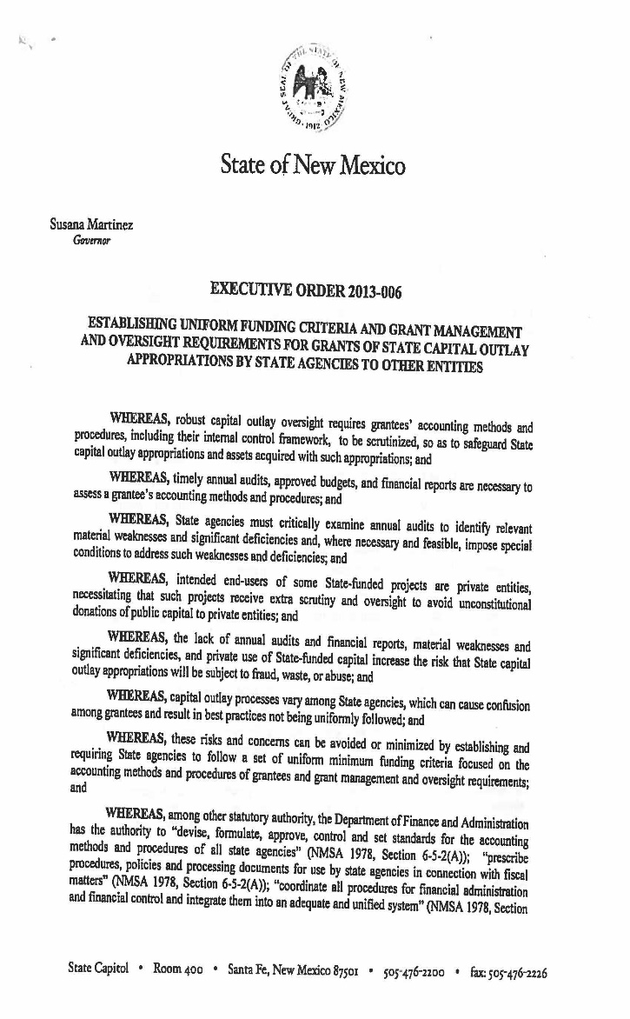
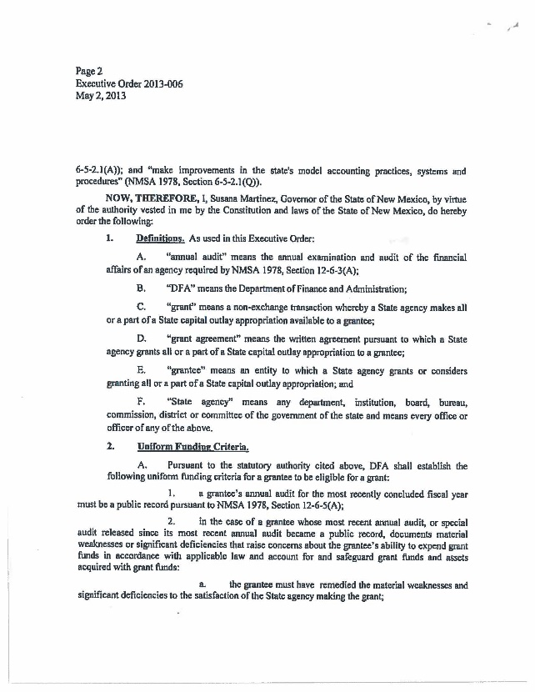
Executive Order – 2013-006

Slide 8
Executive Order (EO) Compliant 2013-006
EO 2013-006 requires state agencies that fund Capital Outlay Projects to review the entities’ annual audits
The review will include:
Looking at the timelines of the audit
The audit findings, including material weaknesses and significant deficiencies
The auditor’s opinion
If not a favorable audit, Grantee can be placed on Special Conditions to avoid not being funded
Special Conditions may require monthly or quarterly financial updates from the Grantees on how internal controls are being corrected

Slide 9
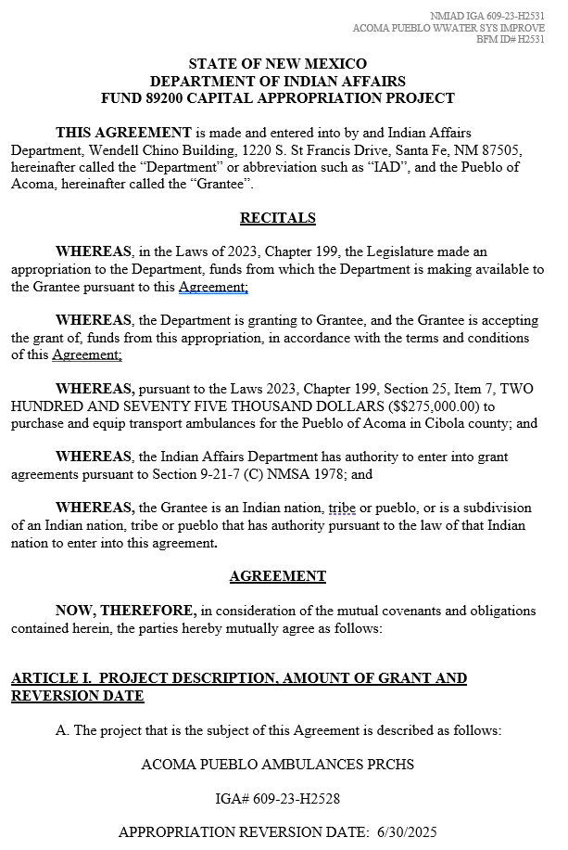
INTERGOVERNMENTAL GRANT AGREEMENT
The IGA is the agreement between IAD and the entity (Tribe).
89200 means it is STB funded
93100 means it is GF funded
Read & review the IGA thoroughly

Slide 10
INTERGOVERNMENTAL GRANT AGREEMENT
Review IGA Language
Appropriation Language – Plan Design Construct Renovate Refurbish Install Equip Purchase
Title of Project
Reversion Date
IGA Number & Amount

Slide 11
INTERGOVERNMENTAL GRANT AGREEMENT
The IGA will provide whether Art in Public Places (AIPP) is taken out from the appropriation
All capital outlay appropriations for new construction or major renovation, 1% must be set aside for the acquisition of public art for that site – 1% or $200,000 maximum
TIF construction projects do not take out AIPP

Slide 12
APPROPRIATION TYPES
Capital Outlay
Identified in Capital Bill (Reversion Date).
4 year for plan, design, construction, demolish, renovate, refurnish.
2 year for purchase (motor grader, vehicle, equipment).
Unexpended balance reverts to back to the State’s Operative Reserve
A request for reauthorization must be submitted through the State Legislature by January 28, 2024, before 3:00 p.m.
TIF
Identified in the IGA.
36 months (3 years) from the date of the execution IGA by the Cabinet Secretary for design and construction projects.
24 months (2 years) from the date of the execution of the IGA by the Cabinet Secretary for planning projects.
Any unexpended balance reverts to the severance tax bond fund.
No Cost Extension must be submitted 60 days before expiration date.

Slide 13
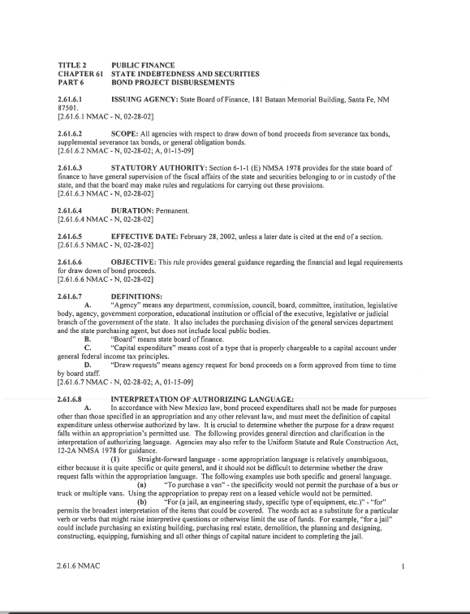
ALLOWABLE EXPENSE
Direct project costs are allowable expenses
Indirect project costs directly to entities are not allowed Indirect project costs include but are not limited to:
Penalty fees, food, room rental for meeting
Damages other than pay for work performed
Attorney fees
Administrative fees i.e. salaries, benefits, building rental fees, utilities, etc.
If you are unsure, refer to the State Board of Finance Disbursement Rule: Bond Project Disbursement Rule | New Mexico Department of Finance and Administration (state.nm.us)

Slide 14
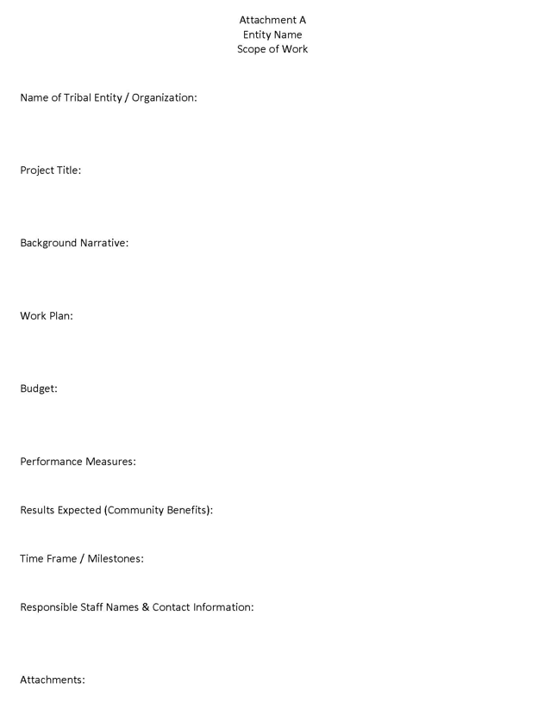
SCOPE OF WORK
Use your preferred organization name.
Use project name on IGA
Provide a brief history of the project and explain the current status.
Provide what phase will be accomplished with the funding
List other funding sources for the project under other, in the budget worksheet. (e.g., other state fund, local funds, or federal funds)
List performance measures your organization will take to ensure the project will be done properly and timely.
Describe how your community will benefit once project is completed.
Describe the milestones of the project and time frame of when it is expected to be complete.
List the names, titles, direct phone number, and emails of those persons working directly on this project, from your organization.

Slide 15
BUDGET FORM
 |  |  | Attachment A
 |  |  | NEW MEXICO INDIAN AFFAIRS DEPARTMENT
_____Tribal Infrastructure Fund __X___Capital Outlay
PROJECT BUDGET
DATE: | 11/30/22 |  |  | PROJECT #: | 609-22-Z3860
NAME OF GRANTEE: |  |  | Example Tribe
CLASSIFICATION |  |  |  | OTHER FUNDS | TOTAL
Administrative Expenses |  |  | Ineligible | $ - | $ -
Engineer Fees
Other Professional Service Fees-Identify
Inspection Fees
Property Acquisition
Construction Cost (Attach Breakdown) |  |  | $900,000.00 | $ 200,000.00 | $1,100,000.00
Equipment (Purchase)
Other Costs (specify) Installation
Contingencies |  |  |  |  | $ -
TOTAL: |  |  | $ 900,000.00 | $ 200,000.00 | $ 1,100,000.00
Identify Sources of Other Funds (Include matching requirements): |  |  | Local Tribal Funds
Are the other funds committed? (Yes/No) |  |  | Yes
If not, when do you expect commitment? |  |  |  | X Grantee Signatory Authority
Project Contact Information: |  |  |  | Alternate Project Contact Information:
Fred Yazzie |  |  |  | Mary Martinez
Phone No: 505-555-5555 |  |  |  | Alternate Phone No: (505) 555-6666
Budget Form (Signed)
_Tribal Infrastructure Fund
_X Capital Outlay
DATE: 11/30/22
PROJECT #: 609-22-Z3860
NAME OF GRANTEE: Example Tribe
CLASSIFICATION: If applicable the amount total listed for the grant award in IGA should reflect the AIPP withdrawn.
TOTAL:
Identify source of other funding (include matching requirements)
Are the other funds committed? (Yes/No)
If not, when do you expect commitment?
X Grantee Signatory Authority: MUST be Signed
Project Contact Information:
Alternate Project Contact Information:
Signed Budget Form

Slide 16
NOTICE OF OBLIGATION (NOO)
The NOO must be completed and submitted to IAD before moving forward with projects or purchases:
a 3rd party agreement must be executed by the parties and is in accordance with the Grantee's procurement code, the approved scope of work as defined in the IGA and with the appropriation language.
documentation of how the third-party agreement was procured (copy of bids/quotes/proposals, copy of RFP, copy of public notice, scoring, etc.)
IAD signs NOO and forwards to IAD Procurement for PO. Once PO is approved, the NOO and PO will be sent to the Grantee.
It could take up to 3 workings days for a PO to be approved with DFA
Entities in receipt of the approved NOO may proceed with the project.

Slide 17
NOTICE OF OBLIGATION FORM
PO or Contract Number
Vendor
Contract amount
Termination date/Reversion date
Date of Request
Grantee Representative
Department Representative
Project Number
Grant Amount
Amount of NOO being requested
Amount of Previously NOOs requested
Total of all NOO requested to Date
NOO is signed by IAD Department Rep.
Title of IAD Rep
Date of Signature

Slide 18
Purchase Order
NOO sent to IAD Procurement.
NOO is reviewed and signed
PO is created in the SHARE system, which will generate the PO number.
DFA reviews the PO and will either approve or deny.
If approved, PO and NOO will be sent to grantee together.
If denied, IAD will reach out to the Tribe to correct the NOO
POs are check by IAD TIF/CO Administrator every morning to see if the PO is approved by DFA.

Slide 19
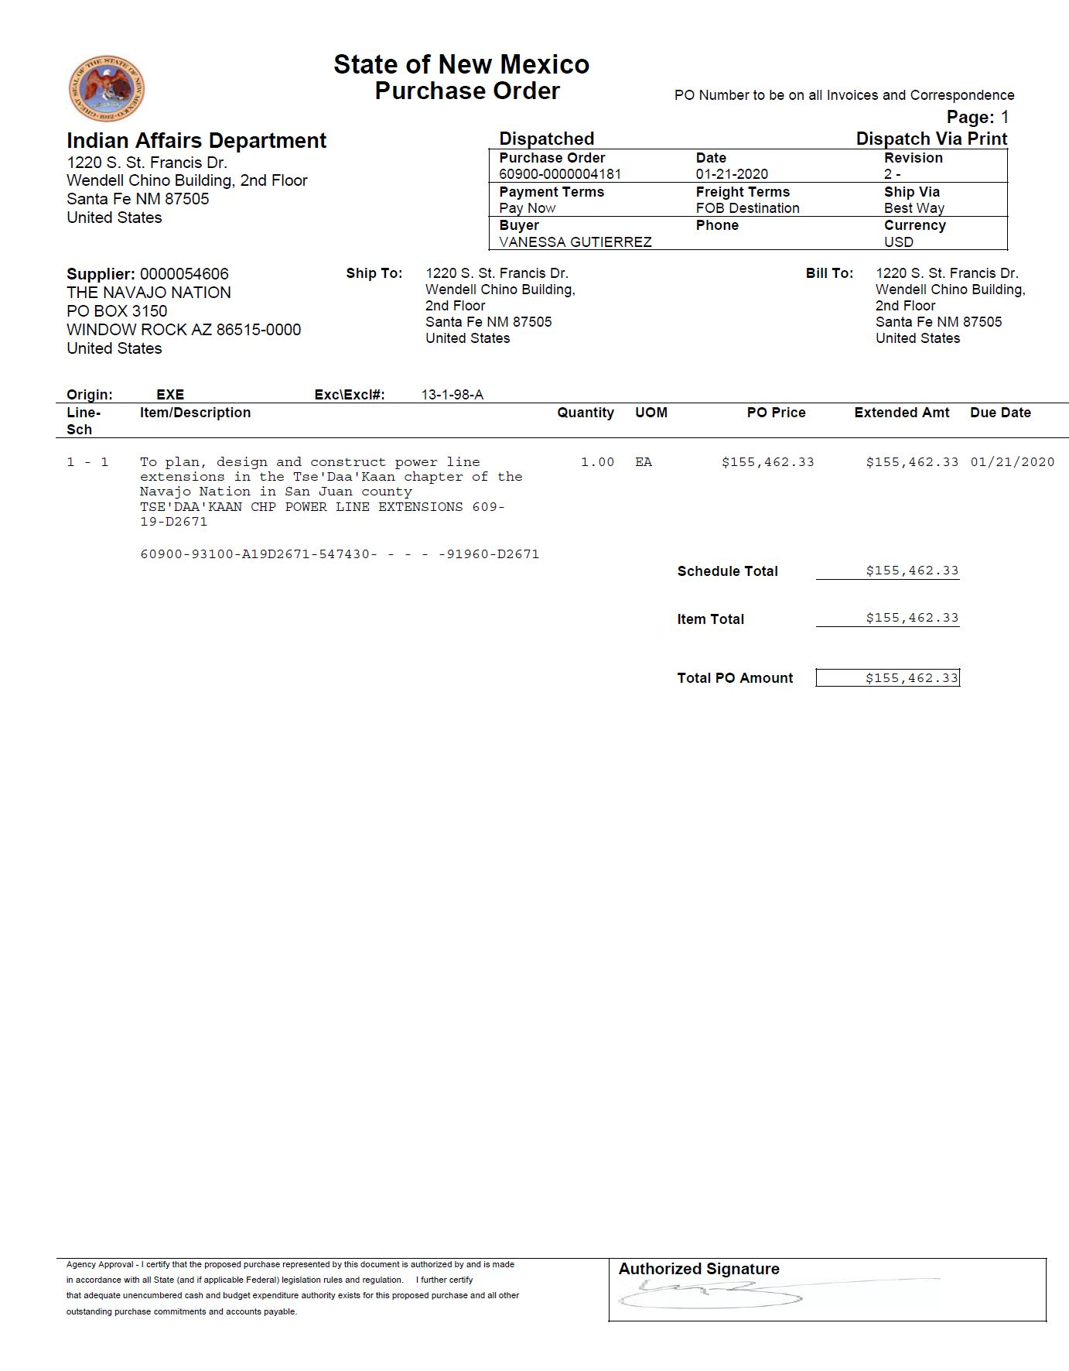
NOO & PO

Slide 20
REIMBURSEMENTS
When submitting a pay request, please ensure all supporting documentation is attached for processing.
Request for Payment Form, Invoice, Front/Back check or ACH, NOO and PO.
The Grantee shall be accountable for their receipts and disbursements relating to the Project’s funds.
Department has the right to reject a payment request if the Department determines the expenses were not permitted or does not comply with the IGA, Scope of Work, Budget or Notice of Obligation.

Slide 21
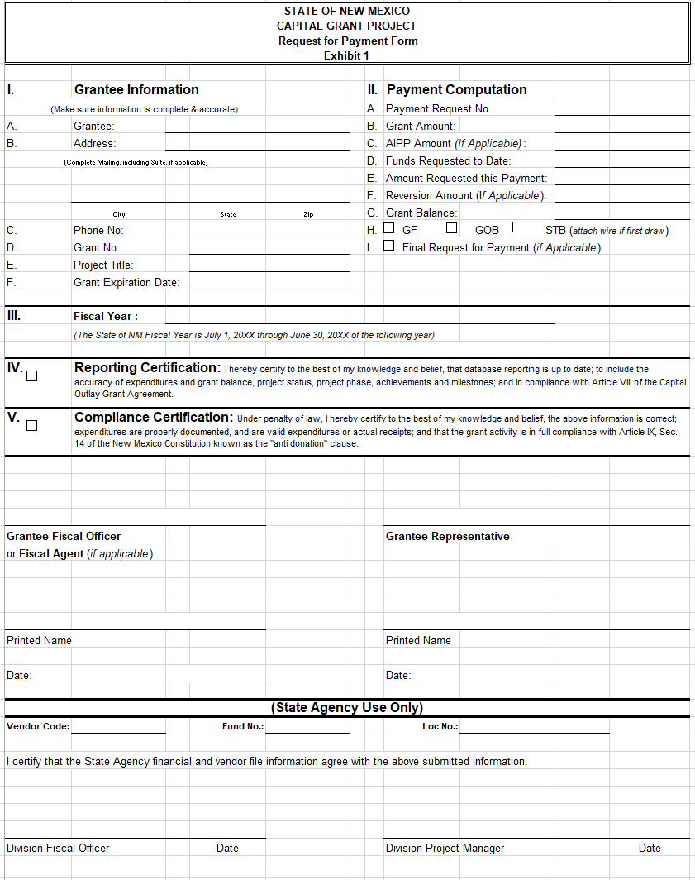

Slide 22
BUDGET FORMULATION & MANAGEMENT
Budget Finance Management (BFM) is now the new web-based system for reporting and monitoring. Capital Projects Monitoring System (CPMS) is no longer utilized.
Recorded BFM Trainings can be found at: https://www.nmdfa.state.nm.us/budget-division/capital-outlay-bureau/
Tribal entities must report into BFM each quarter, per the IGAs. When logging in, use the Letter “E”. For example: EXXXXX then your password.
FY 2024 BFM Quarterly Reporting
Local Entity Reporting
July 01, 2023 - August 31, 2023
October 01, 2023 – November 30, 2023
January 01, 2024 – February 29, 2024
April 01, 2024 – May 31, 2024

Slide 23
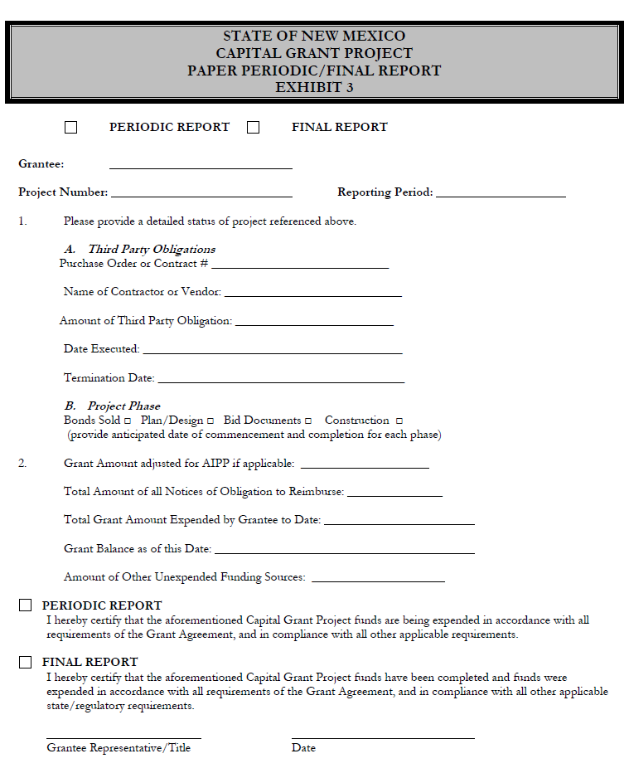
FINAL REPORT
Submit your Final Report to IAD by checking the “Final Report" box.
Attach a brief statement describing the completed project.
Ensure project amount and balance are correct.
Attach supporting documents with final pay request form.
Submit a Reversion Letter, if appropriation not fully expended.
Due within 20 days after the reversion date or early termination.

Slide 24
REVERSIONS
Reversion Letter is required to close out CO/TIF projects.
Due within 20 days after the expiration date or early termination with final pay request packet.

Slide 25
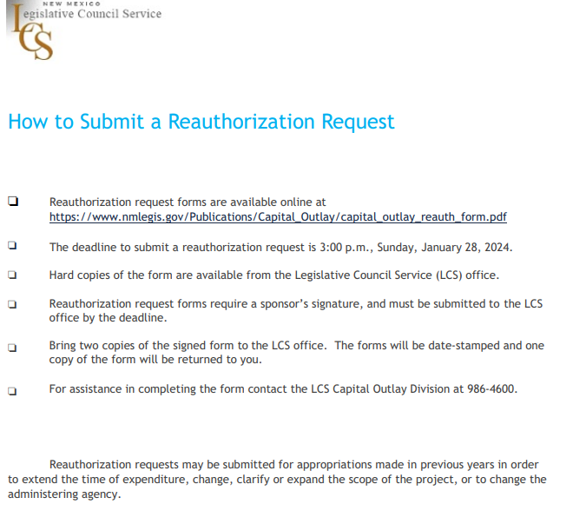
REAUTHORIZATIONS
Reauthorization requests may be submitted for appropriations made in previous years to extend the time of expenditure, change, clarify or expand the scope of the project, or to change the administering agency.

Slide 26
REMINDERS
Funding is only available after the bonds are sold through the State Board of Finance (SBOF).
Submit your Tribal Audits.
Complete the Bond Questionnaire.
Obligate the 5% or the full amount within 6 months.
If the project is not moving forward in any significant way or at a reasonable pace, the IGA and the award may be suspended or terminated.
Please submit RFP’s timely especially during the State’s fiscal close out to avoid delay in payment for both TIF and CO RFP’s.
Any questions please contact our office.

Slide 27
OTHER INFORMATION
HB 505 - All Capital Outlay Projects need to be obligated by June 30, 2024, for both four (4) year and two (2) year projects
If not obligated, the funds will revert to the State
Once IGA is executed, please obligate the funds

Slide 28
THANK YOU

Slide 29
Contact Information
Monica Maestas
Chief Financial Officer
Monica.Maestas@iad.nm.gov
(505) 690-5694
Vanessa Gutierrez
Finance Supervisor
Vanessa.Gutierez@iad.nm.gov
(505) 469-9476
Ellia Lopez
Accountant/Auditor
Ellia.Lopez@iad.nm.gov
(505) 479-1523
Josett Monette
Deputy Cabinet Secretary/General Counsel
(505) 690-1661
Josett.Monette@iad.nm.gov
Lawrence John
TIF/Capital Outlay Administrator
Lawrence.John@iad.nm.gov
(505) 690-2997
Connie Garcia
TIF/Capital Outlay Administrator
Connie.Garcia@iad.nm.gov
(505) 490-0545

