Slide 1
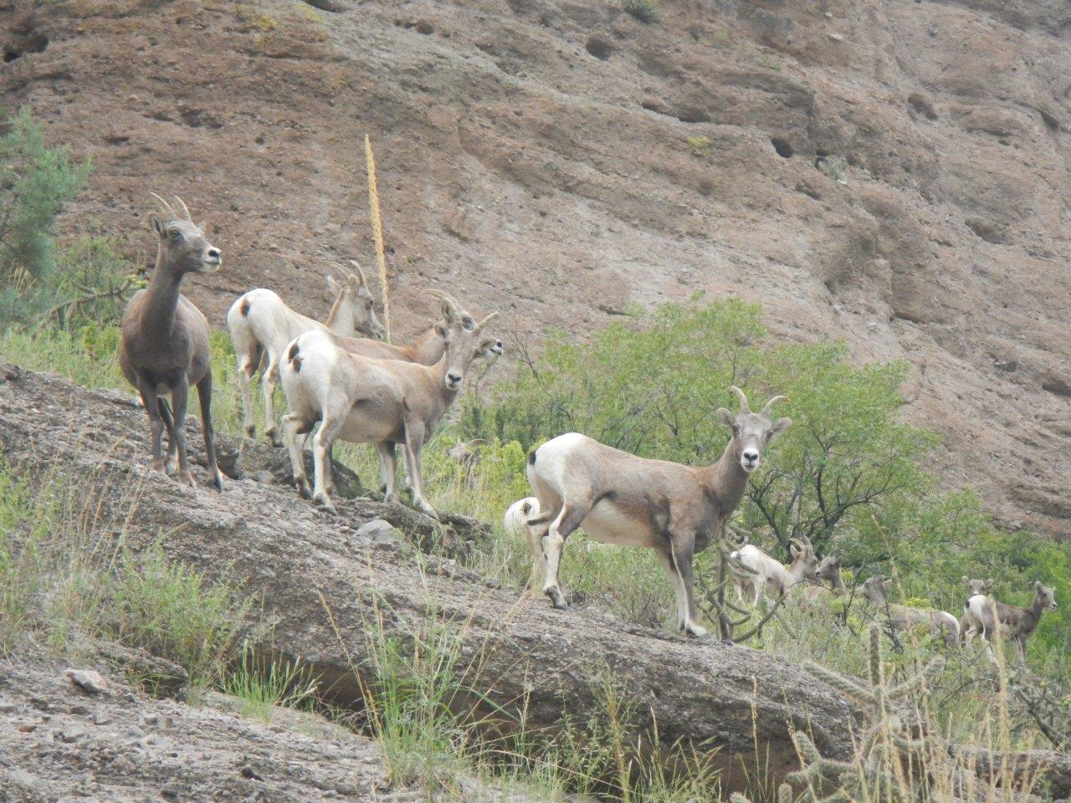
2020 STATE TRIBAL LEADERS SUMMIT
New Mexico Department of Game and Fish
Conserving New Mexico’s Wildlife and for Future Generations
conserve, regulate, propagate and protect the wildlife and fish within the State using a flexible management system. This ensures the sustainable use for public food supply, recreation, safety, provide for off-highway motor vehicle recreation and recognizes cultural, historic resource values while ensuring public safety. Department monitors, assesses, conserves, restores, and regulates the use of game, fish, and other wildlife, manages habitat, and provides relevant technical guidance, information and education, and depredation interventions. The Department provides objective and balanced conservation programs to benefit the full range of wildlife species and their habitats.
Community outreach with Tribes Pueblos and Nations
The Department is always open to dialogue with Sovereign governments' in the concerns to wildlife education of shared habitat conservation, cultural and common wildlife issues.
Jack Young
Tribal Liaison
(505) 476-8141
Jack.young@state.nm.us

Slide 2
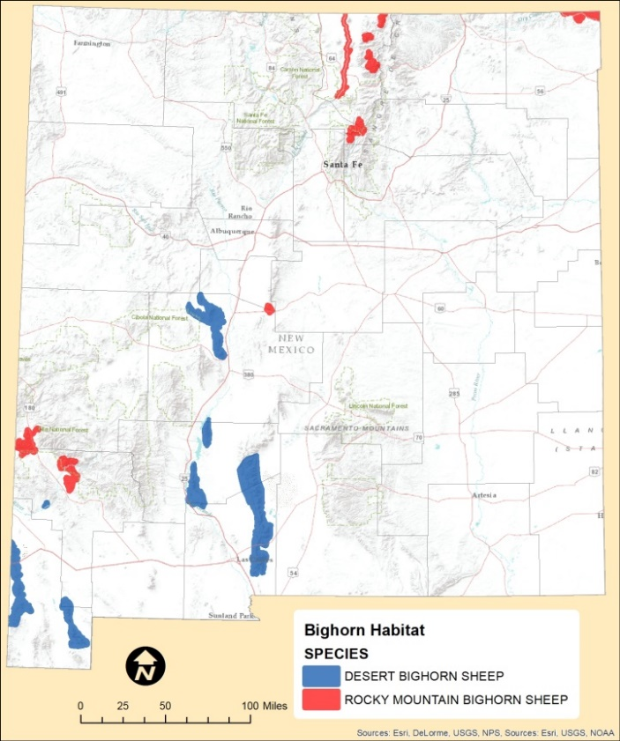
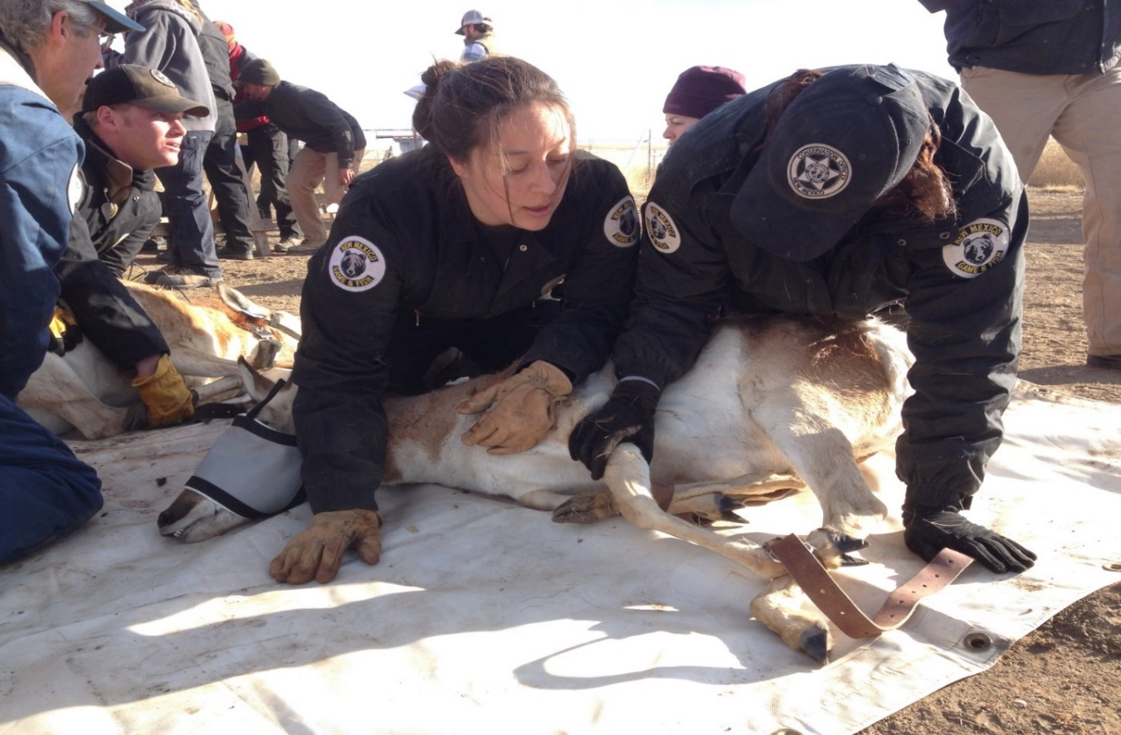
I. Field Operations Program - NMDGF Regulates hunting and Fishing throughout the state of New Mexico within Public, Private and State, judications’ II. Conservation Services Program - NMDGF through Conservation Services provides for wildlife enhancement, health and propagation state wide.
2020 STATE TRIBAL LEADERS SUMMIT
Department of Game and Fish Programs

Slide 3
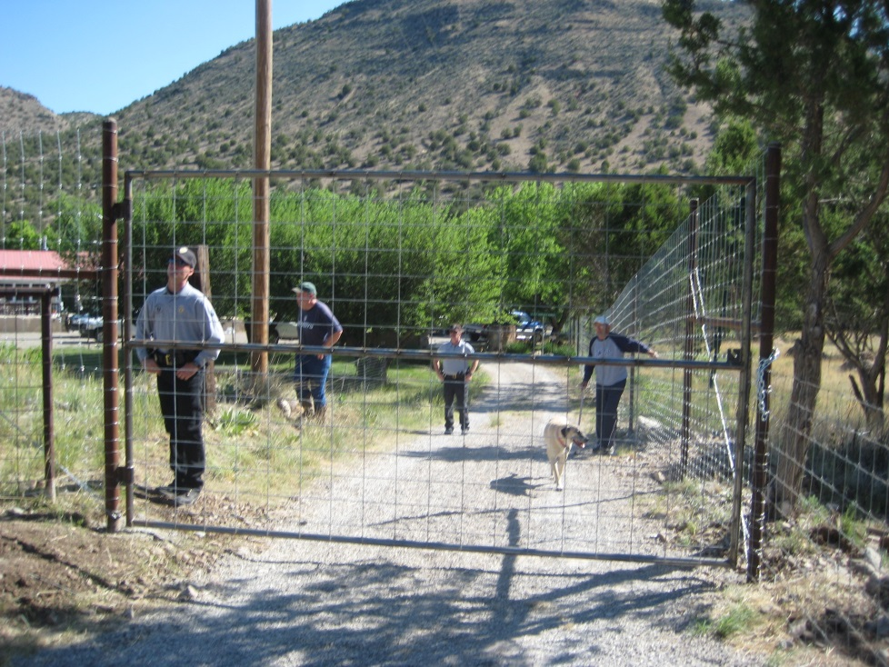
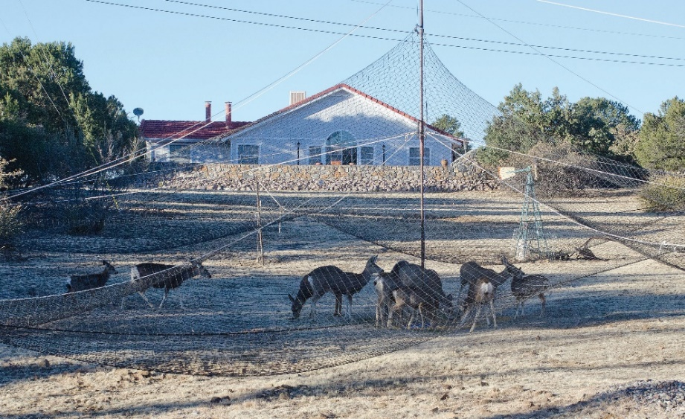
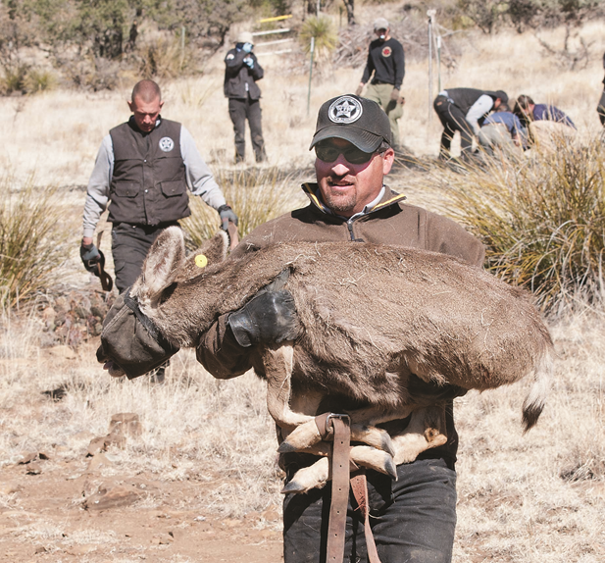
2020 STATE TRIBAL LEADERS SUMMIT
Department of Game and Fish Programs Con’t.
III. Wildlife Depredation and Nuisance Abatement Program - NMDGF wildlife depredation and Nuisance wildlife efforts strive to find appropriate solutions to protect wildlife populations and private commercial endeavors with case by case actions
IV. Administration Program - Through statewide hunters' education programs NMDGF works with communities to inform the hunting public the safe and best practices of hunting. NMDGF have worked with Nations, Tribes and Pueblos on hunters safety programs.

