Slide 1
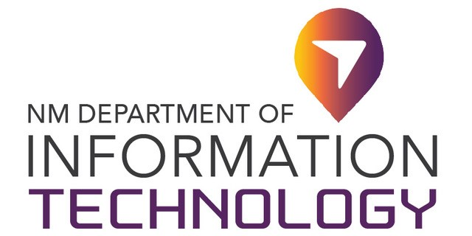
2020 STATE TRIBAL LEADERS SUMMIT
Department of Information Technology
Develops the State’s strategic direction for information technology (IT)
Delivers enterprise IT services and telecommunications for the State’s executive agencies
Performs oversight of IT projects and procurements
Department of Information Technology (DoIT) also provides guidance and support to local governments and tribal entities for broadband planning and geospatial technology.
Key Contacts:
John Salazar, DoIT Cabinet Secretary Designate
and State Chief Information Office
Gar Clarke, DoIT Tribal Liaison
Phone: 505-690-1661
george.clarke@state.nm.us

Slide 2
2020 STATE TRIBAL LEADERS SUMMIT
Programs Department of Information Technology
New Mexico Broadband Program:
Completed a rural broadband assessment and statewide strategic plan that provides a clearly defined strategic path for broadband investments in New Mexico
Executed an Intergovernmental Agreement (IGA) with the Navajo Nation for the $3M capital outlay appropriation to the Navajo Nation Broadband Project. Project will provide services to 26 Tribal Schools and 41 Chapter Houses/Developing Libraries through the construction of over 380 miles of fiber.
Awarded $2.9M through an IGA with the Pueblo of Cochiti to expand broadband access in the community. Project will provide services to their residents and government facilities.
EDA awarded DoIT a $1.5M grant to support public agencies and tribal entities feasibility and technical planning services for broadband infrastructure projects
Built and maintain Broadband Mapping to support data required for planning broadband expansion into communities.
Project Pueblo Connect: Providing coordination activities and technical support to a National Science Foundation Grant for broadband access to three tribal communities. ($1.2M)
Project Television White Space for Pueblo Libraries: Providing coordination activities and technical support for a federal grant to provide broadband to three tribal communities. ($300K)

Slide 3
2020 STATE TRIBAL LEADERS SUMMIT
Programs Department of Information Technology
New Mexico Geospatial Technologies:
  NM Geospatial Advisory Committee (GAC): Tribal representation on the GAC to provide statewide data acquisition coordination
  Coordinate the acquisition of services for the following:
    Elevation data that includes tribal communities to support engineering, flood control, wildfire mitigation, construction projects, etc.
    Address and road data supporting public safety for accurate dispatch of emergency services.
    Hydrology data of streams and waterbodies to support flood modeling, agriculture irrigation needs, statewide water transport, water rights, etc.
    Federal Aerial Imagery data acquisition and deployment to support land use analyses, forest health, soil assessment, general mapping of features, etc.
    Provided Statewide Price Agreements for Geospatial Services and Products to provide a legal procurement vehicle saving time and work resources from duplicating efforts

Slide 4
2020 STATE TRIBAL LEADERS SUMMIT
Achievements Department of Information Technology
Three Achievements:
Convened the Homework Gap Team to collaborate on providing affordable and reliable internet access to students. The HGT includes Tribal Representation from the Indian Affairs Department, PED Indian Education Division, Navajo Nation, and Santa Fe Indian School
Collaborated with PED to inventory and distribute over 6,000 Chromebooks to tribal entities
Facilitated WiFi Hotspot roll-out to tribal communities, providing critically needed internet access for students, and health and safety support

