Slide 1
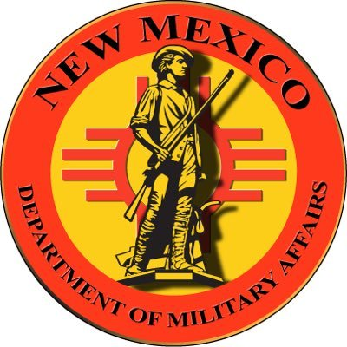
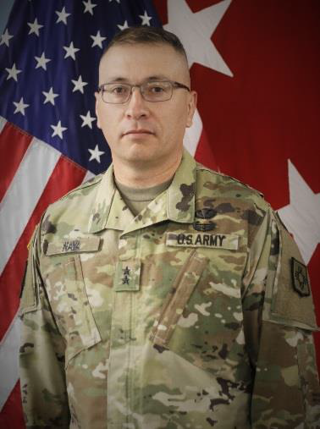
2020 STATE TRIBAL LEADERS SUMMIT
Department of Military Affairs
The New Mexico Department of Military Affairs (DMA) is a cabinet-level agency which provides infrastructure support to the New Mexico National Guard (NMNG). Provides the necessary infrastructure required to support the Army and Air National Guard, State Defense Force and Civil Air Patrol missions
Mission
To support the NMNG vision, DMA will provide the necessary infrastructure required to support the Army and Air National Guard, State Defense Force and Civil Air Patrol missions. The DMA will optimize the use of all facilities, ranges and installations.
Key Contacts
Steve Latimer
Tribal Liaison
10 Bataan Boulevard
Santa Fe, NM 87508
Tel: (505) 407-3300 ext.20040
Fax: (505) 474-8231
Email: Steven.Latimer3.nfg@mail.mil
Major General Kenneth Nava
The Adjutant General of NM
Phone: 505-407-3350
Email: Kenneth.a.nava.mil@mail.mil

Slide 2
On 27 October 1999, the Department of Defense (DoD) promulgated its annotated American Indian and Alaska Native policy, which emphasizes the importance of respecting and consulting tribal governments on a government-to-government basis. The policy requires an assessment, through consultation, of the effect of proposed DoD actions that may have the potential to significantly affect protected American Indian tribal resources, American Indian Tribal rights, and American Indian lands before decisions are made by the services.
The NMNG offers the National Guard Youth ChalleNGe Academy which is a boot-camp program for at-risk youth. It offers structure, discipline, and a chance for troubled youth to exercise discipline, encourage growth in maturity, provides positive support to help turn their lives around. It is not exclusively for Native American youth, but many Native youths have benefitted from this opportunity.
The NMNG Anti-Drug Unit has taken its climbing wall and anti-drug message to the various tribal job fairs, and is available upon request to all Pueblos, Tribes and Nations in New Mexico.
The NMNG has worked on developing a program which would allow NMNG personnel and equipment (e.g. graders, front-end loaders) to be used on tribal land in order to assist Tribes with infrastructure improvement issues.
2020 STATE TRIBAL LEADERS SUMMIT
Programs

Slide 3
2020 STATE TRIBAL LEADERS SUMMIT
Accomplishments
The NMNG has conducted consultations with interested tribes concerning training, land surveys and clearances.
The NMNG has invited New Mexico Tribes, Pueblos and Nations to a Tribal Meeting in which topics of interest to the tribes were discussed and information was provided on the NMNG’s stewardship practices.
The NMNG continues to assist tribal nations during the current 2020 Global COVID-19 Pandemic, wildfires, and other crises when needed. Training and education is also provided about opportunities to serve their State and community with the NMNG.

