Slide 1

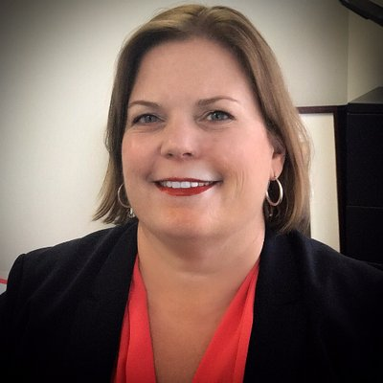
2020 STATE TRIBAL LEADERS SUMMIT
Early Childhood Education & Care Department
Investing for tomorrow, delivering today
The New Mexico Early Childhood Education and Care Department (ECECD) was created through Senate Bill 22- passed by the New Mexico Legislature and signed into law in March 2019 by Governor Michelle Lujan Grisham - working to ensure that all New Mexican families and young children have equitable access to high-quality early childhood experiences and opportunities
The New Mexico Early Childhood Education & Care Department works to:
Collaborating with state and federal partners and agencies, tribal government for early childhood development.
Consult with nations, tribes and Pueblos for the delivery of learning guidelines in language, culture and history.
Expand appropriate Indian education programs for infants, toddlers and children pursuant to ICWA.
Ensure language and culture considerations are included in programs administered through the department.
Key Contacts
Elizabeth Groginsky
Cabinet Secretary
505-476-7053
elizabeth.groginsky@state.nm.us
Jovanna Archuleta
Assistant Secretary for Native American Early Education and Care/Tribal Liaison
Jovanna.Archuleta@state.nm.us
505-699-7013
www.nmececd.org

Slide 2

2020 STATE TRIBAL LEADERS SUMMIT
2021 Legislative Session Priorities
Sustain and build on current investments
Enhance the early childhood workforce
Expand access to PreK and evidence-based home visiting
Investing for tomorrow, delivering today​

Slide 3
2020 STATE TRIBAL LEADERS SUMMIT
Policy Initiatives/Programs
As the New Mexico Early Childhood Education and Care Department continues to grow, some initiatives to support tribal educators and families include:
Development of an Early Childhood Equity Council
Convening of the American Indian Language Policy Research and Teacher Training Center – UNM
Development of a digital culturally relevant curriculum framework
Support for individuals to attend the Indigenous Montessori Institute
Tribal Liaisons from each of the ECECD Divisions.
ECECD now oversees the following programs:
Head Start Collaboration Office – Olga Valenzuela-Zavala is the Head Start Collaboration Director and works to support Head Starts across the State.
Home Visiting – home visiting services that promote maternal, infant, and early childhood health, safety, development, and strong parent-child relationships.
Family Infant Toddler (FIT) Program Early Childhood Intervention- Provides families if infants and toddlers with or at-risk of developmental delays with high-quality early intervention supports and services.
Families FIRST – Registered nurses assists families in gaining access to medical, social, and educational resources that are necessary to foster positive pregnancy outcomes and promote healthy infants and children in New Mexico.
Child Care – provides child care assistance to parents/legal guardians who are working, going to school or in a job training programs with child care expenses.
New Mexico PreK – prepares three and four-year0old children for school readiness through funding from ECECD.
Family Nutrition – administers two USDA programs to support young children and adults in healthy growth and development.
Investing for tomorrow, delivering today​

Slide 4

2020 STATE TRIBAL LEADERS SUMMIT
Top three achievements accomplished on behalf of tribes
Delivered food, personal protective equipment (PPE), and infant wellness packages to tribes across our State to support families and early childhood educators during the health emergency.
Established a partnership with SIPI to support a Cohort of 10 Pueblo women starting their journey learn about early childhood development.
Conducted a Early Childhood survey in partnership with the Indian Affairs Department on an early childhood priorities and needs within each tribe.
Investing for tomorrow, delivering today​

