Slide 1
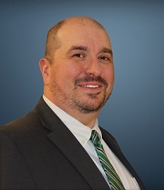
2020 STATE TRIBAL LEADERS SUMMIT
Energy, Minerals and Natural Resources Department
Our mission is to position New Mexico as a national leader in energy and natural resource management
EMNRD is committed to being a resource by:
Providing technical support, training, and partnership through our Forestry and Energy Conservation and Management Divisions
Support sampling, testing, and inspecting oil and gas development through the Oil Conservation and Management Division
Partnering with tribal communities to ensure proper mine safeguarding and clean up
Coordination of outdoor education and recreation opportunities through the State Parks Divison
Key Contacts: Sarah Cottrell Propst, Cabinet Secretary sarah.propst@state.nm.us 505.472.3200
Todd Leahy, Tribal Liaison todd.leahy@state.nm.us
505.670.5921
Staff Directory

Slide 2
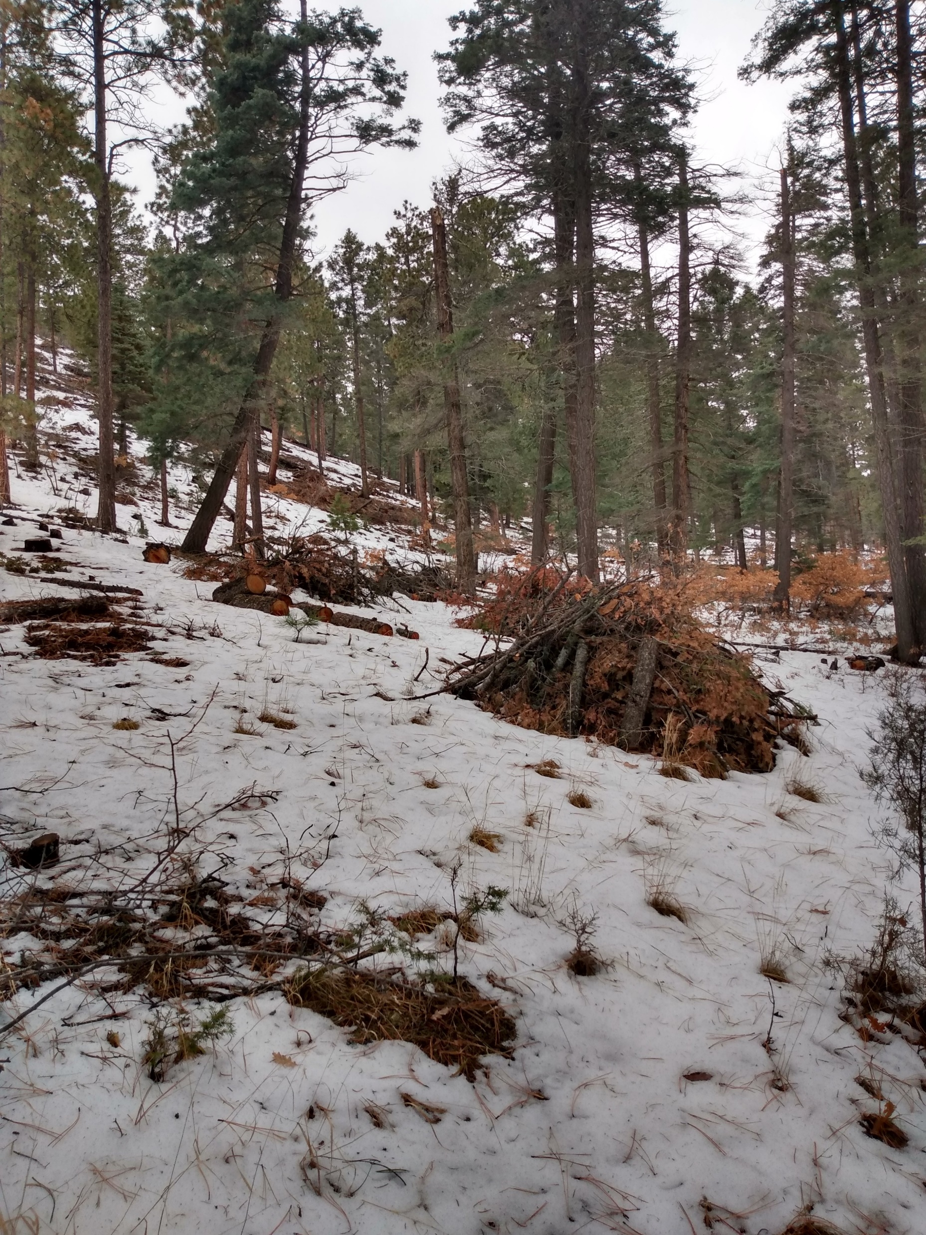
2020 STATE TRIBAL LEADERS SUMMIT
2021 Legislative Session Priorities
Improving forest management
New Mexico saw its longest fire season ever this year, our proposal will directly address the threat of climate change through better forest management by utilizing prescribed fire
Improving mining reclamation
Ensuring that reclamation work can always occur by allowing for bond forfeiture
Notes:
Pictured: Pile burns in Hyde Memorial State Park, an important part of forest management.

Slide 3
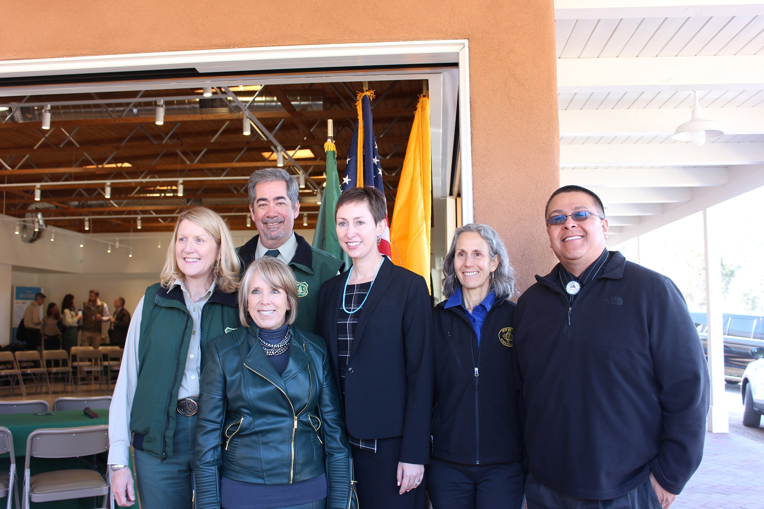
2020 STATE TRIBAL LEADERS SUMMIT
Policy Initiatives and Programs
Forest Management
Shared Stewardship and Forest Action Plans
Provide fuel wood to Native elders in various communities
Fire Response Learning Network
USFS Tribal Forest Managers Grant support
Mine Reclamation:
Securing and safeguarding heritage mine sites across the state
Outdoor Recreation:
Rio Grande Trail: dedication to tribal consultation, cooperation, and input
Educational and programmatic initiatives in 35 state parks
Renewable Energy Development
PV on a Pole program
Statewide technical support
Tribal community radioactive materials transportation
Technical support and training for NM tribal communities
Notes:
Pictured: 2019’s Shared Stewardship signing ceremony

Slide 4
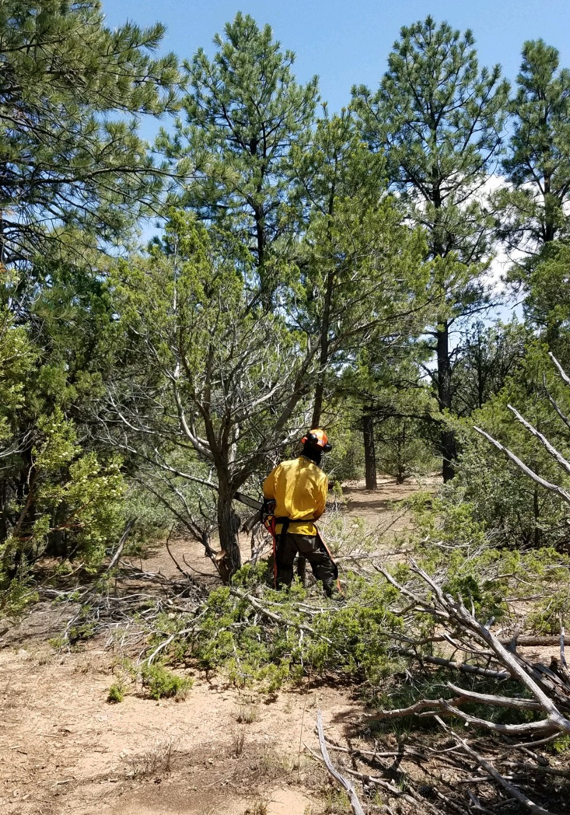
2020 STATE TRIBAL LEADERS SUMMIT
Top three achievements accomplished on behalf of tribes
Elevated role of Tribal Liaison to the Office of the Secretary and developed new policy to encourage working more closely with tribes, nations, and Pueblos
Shared Forest Stewardship Agreement and forest action planning with robust tribal input
Working closely with tribal partners in the northwest to ensure safe and secure oil and gas development
Notes:
Pictured: thinning project in State Park (Either Coyote Creek or Manzano Mountains)

