Slide 1
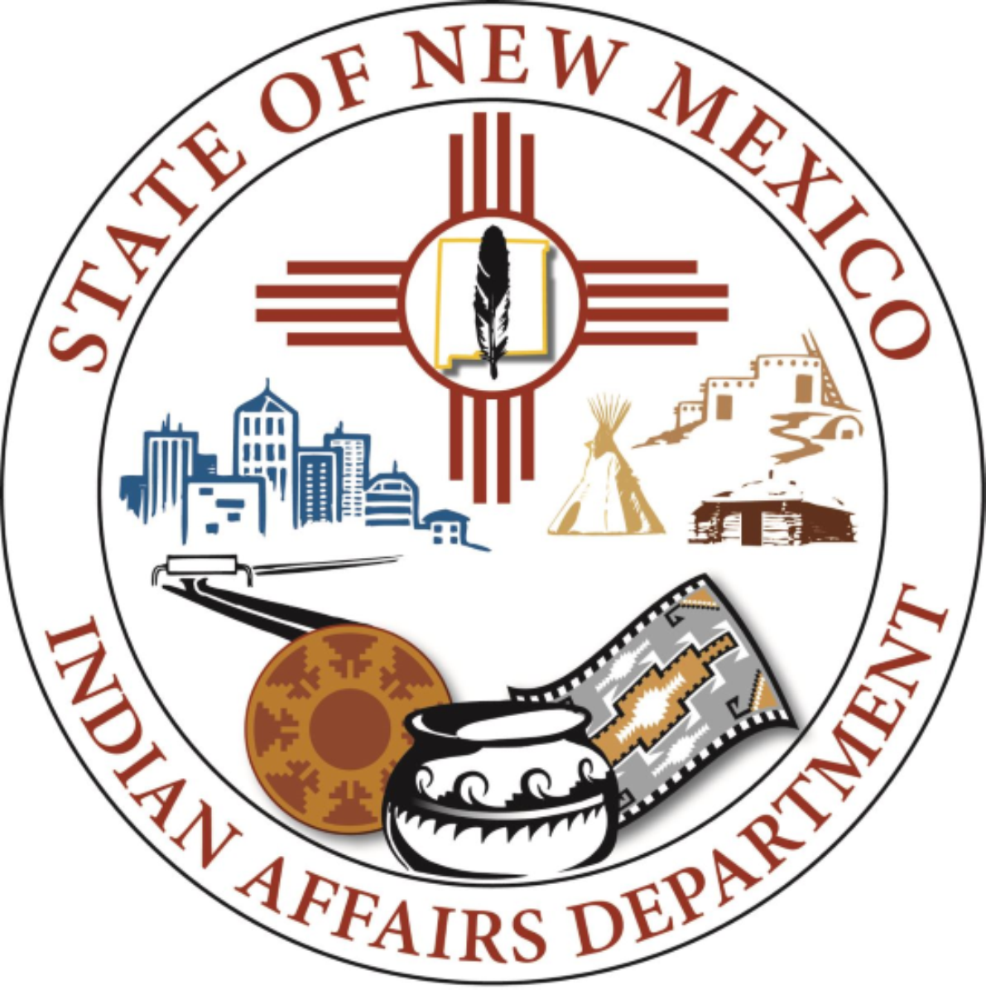
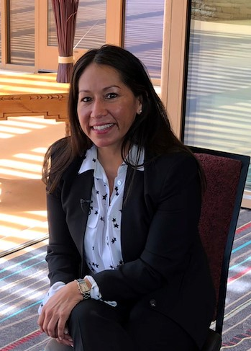
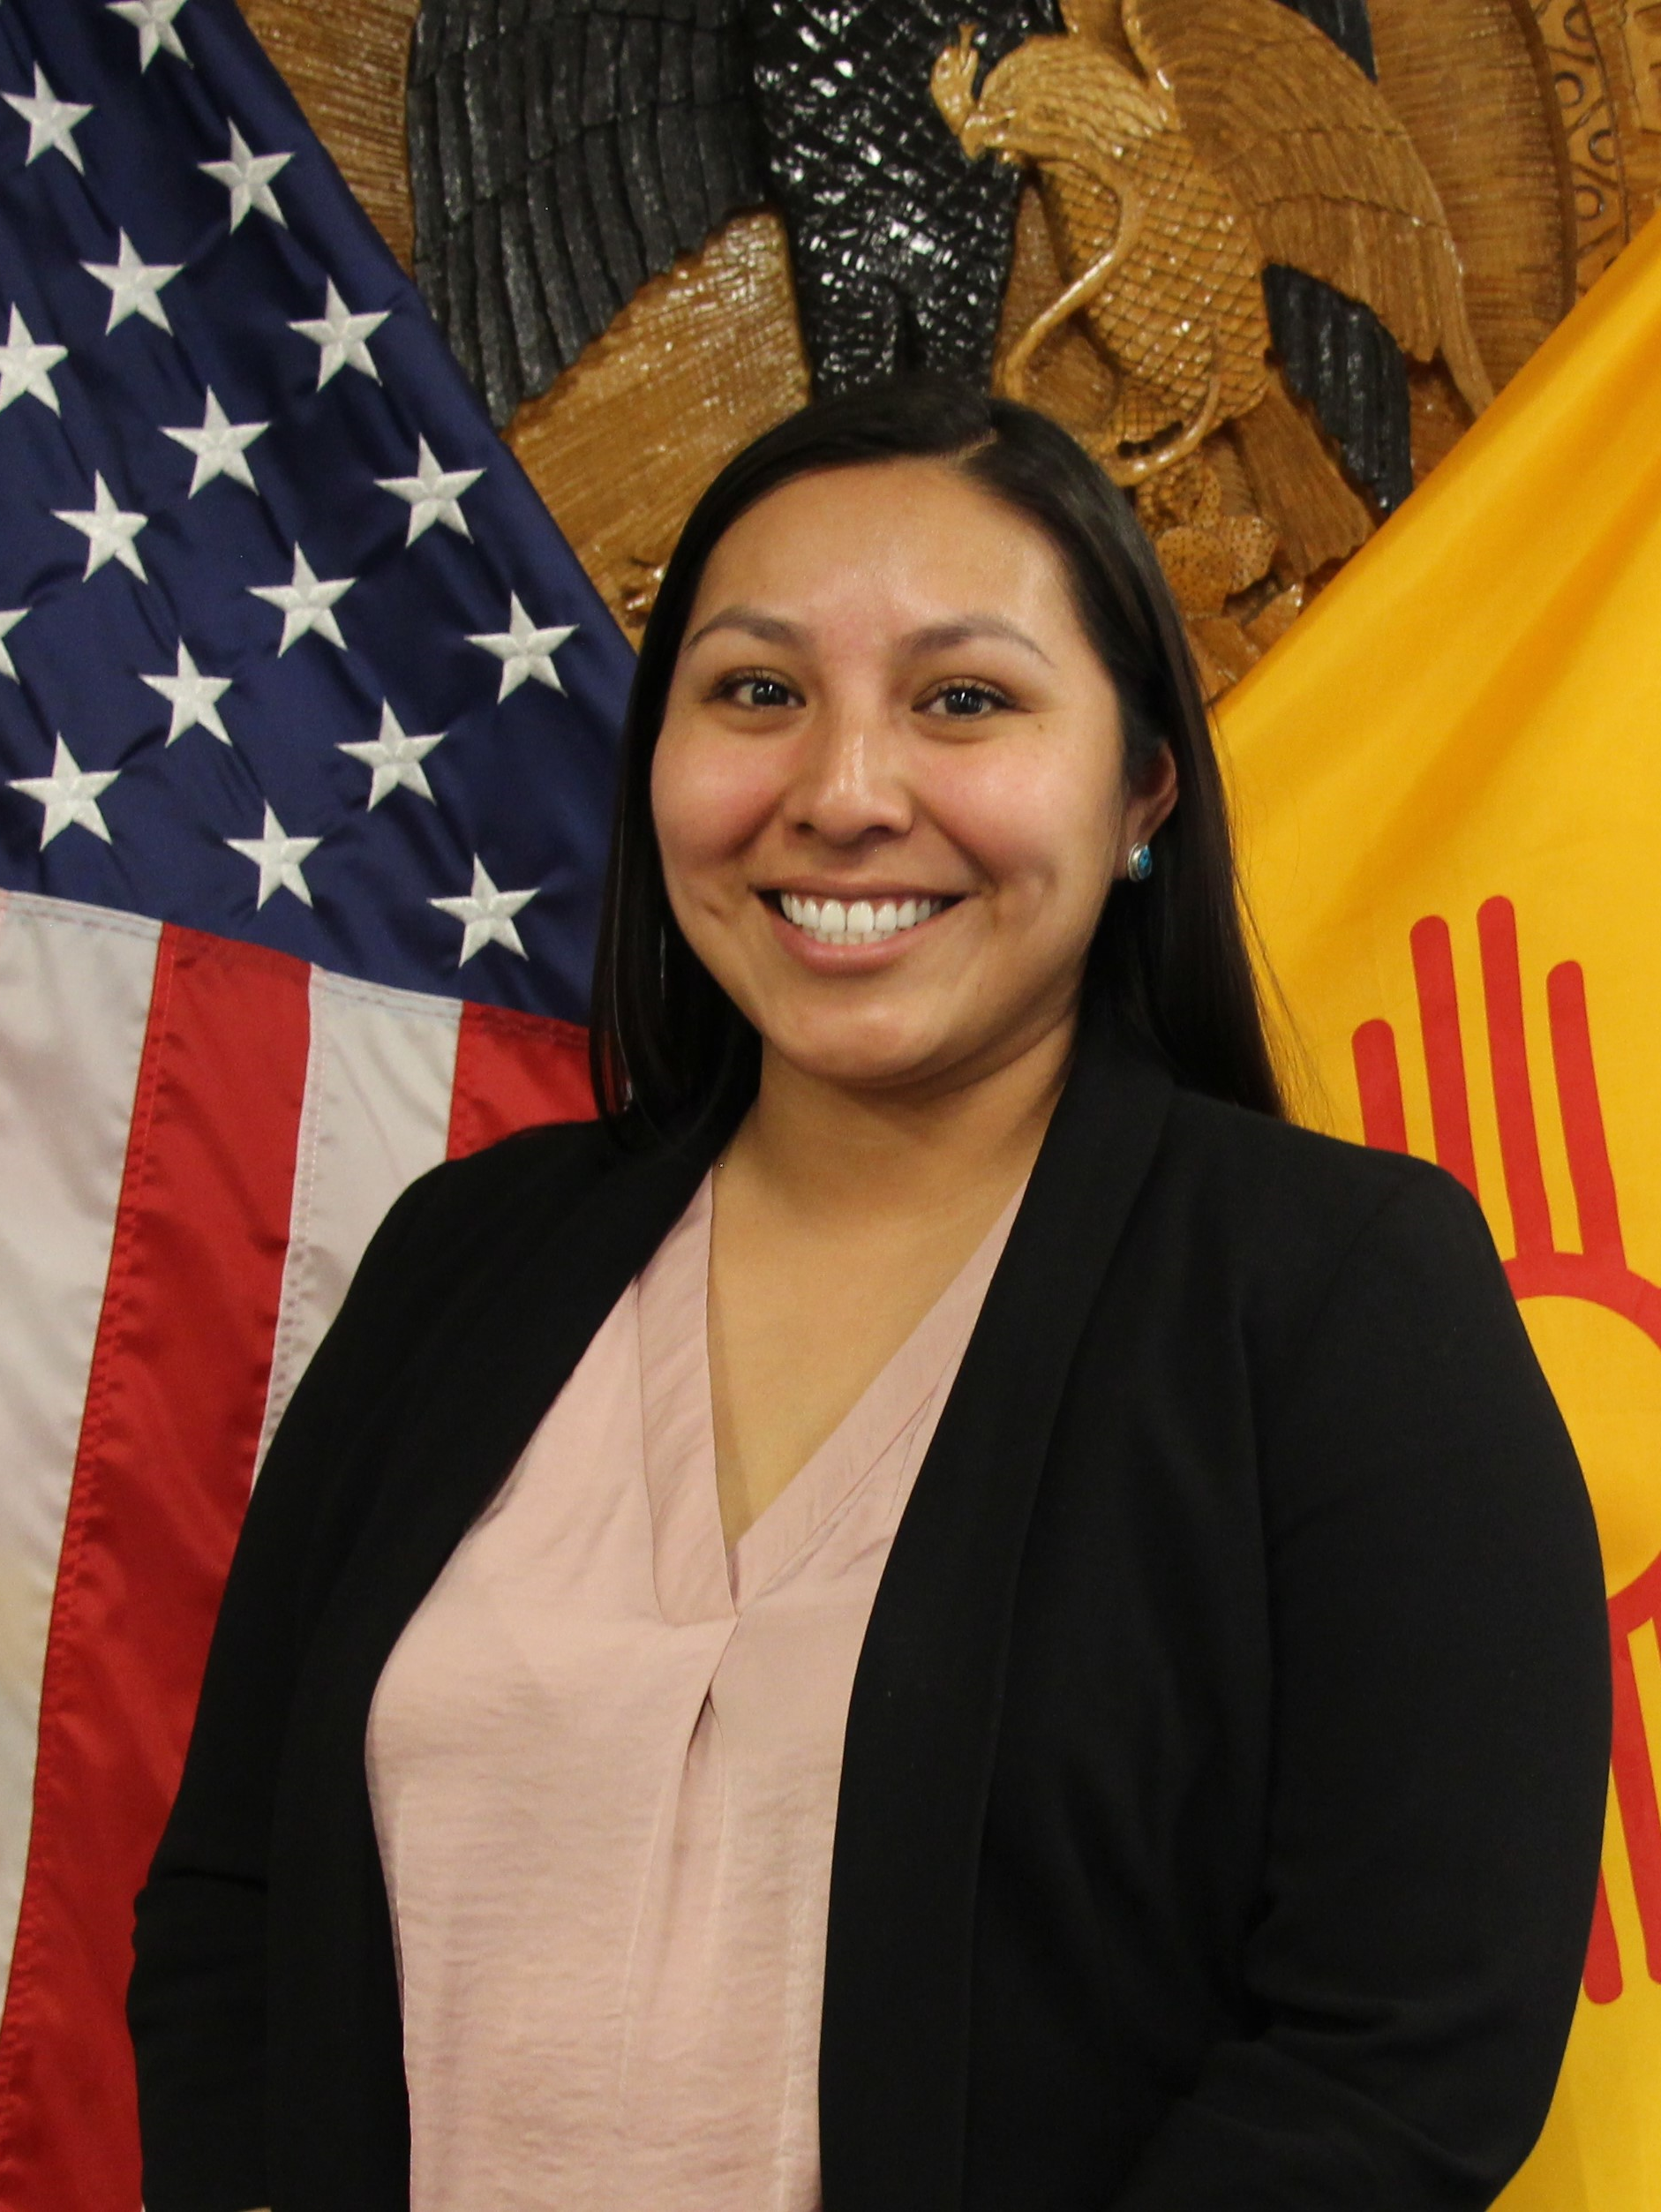
2020 STATE TRIBAL LEADERS SUMMIT
Indian Affairs Department
Vision - Our vision is that tribal nations, tribal communities, and Indigenous people are happy, healthy, and prosperous and that traditional ways of life are honored, valued and respected.
Mission
The NM Indian Affairs Department is committed to be a resource by:
Advocating for tribal interests at state and federal levels through policy and legislative work;
Supporting tribes with access to resources, technical assistance, and funding opportunities; and
Connecting tribes with the executive branch, other tribes and with the tools and resources they need to be self-governing and self-sufficient.
Key Contacts
Lynn Trujillo
Cabinet Secretary
Phone: 505-490-1447
Email: Lynn.Trujillo@state.nm.us
Nadine Padilla
Deputy Secretary
Phone: 505-469-3290
Email: Nadine.Padilla@state.nm.us
IAD Website & Staff

Slide 2
2020 STATE TRIBAL LEADERS SUMMIT
2021 Legislative Session Priorities
Support legislation that positively impacts tribal communities, including legislation regarding health, behavioral health, environment, water, education, and racial justice initiatives
Tribal Infrastructure Fund (TIF) Protections
Support other agency’s legislation that impacts tribal communities

Slide 3
2020 STATE TRIBAL LEADERS SUMMIT
Policy Initiatives/Programs
Policy Initiatives
MMIW: In 2019, Governor Michelle Lujan Grisham established the Missing and Murdered Indigenous Women Task Force Act, which will collaborate with tribal governments, tribal law enforcement, and the U.S. Department of Justice to determine the scope of the problem, identify barriers, and create partnerships to improve processes for reporting and investigating cases. The task force, which was appointed in October 2019, must report its finding and recommendations to Governor Lujan Grisham, the legislative council service library, and the appropriate legislative committees before November 1, 2020.
ETA: Developed over the course of a year with collaboration by community organizations, unions, energy groups and advocates, the Energy Transition Act (ETA) establishes New Mexico as a national leader in clean energy. The ETA sets a statewide renewable energy standard of 50 percent by 2030 for New Mexico investor-owned utilities and rural electric cooperatives and a goal of 80 percent by 2040, in addition to setting zero-carbon resources standards for investor-owned utilities by 2045 and rural electric cooperatives by 2050. The law transitions New Mexico away from coal and toward clean energy, ensuring greater renewable energy production and reducing costs for consumers, and provides tens of millions of dollars of economic and workforce support for communities impacted by coal plant closures, as well as the development of renewable replacement power in San Juan County.
Census: The New Mexico Indian Affairs Department was awarded funds to provide outreach activities that inform nations, tribes, pueblos and urban American Indians within New Mexico of the importance of self-responding to the 2020 Census questionnaire and avoiding an undercount.
Programs
Tribal Infrastructure Fund: All federally recognized tribes, nations and pueblos within New Mexico have an opportunity to submit a robust project proposal for their community. At each funding cycle, the project proposal is evaluated and based on scoring, is awarded funds through the 13-person Tribal Infrastructure Board, which is administratively attached to the New Mexico Indian Affairs Department.
Capital Outlay: Funds are used to build, improve or equip physical property that will be used by the public. Capital outlay is funded through three sources: general obligation bonds, severance tax bonds and nonrecurring general fund revenue. Amounts vary from year to year depending on the economy.
Tobacco Cessation & Prevention Program: (IAD) is focused on building tribal capacity to implement culturally appropriate tobacco cessation and prevention initiatives that recognize the unique ceremonial uses of tobacco while reducing the use of commercial tobacco use and its harmful effects.
Special Projects Grant Program: Funds are meant for direct services to Native American citizens, indirect and administrative costs shall be kept to a minimum. Funding is not intended to be a permanent funding source for entities but rather a short-term allocation.

Slide 4
2020 STATE TRIBAL LEADERS SUMMIT
Top three achievements accomplished on behalf of tribes
Food, Water and Personal Protective Equipment relief to Nations, Tribes, and Pueblos through the COVID-19 pandemic.
In partnership with state agencies (DHSEM – EOC, CYFD, ECECD, HSD, NMAD), private relief funds, and donations received IAD coordinated delivery of resources to Nations, Tribes, and Pueblos
Worked to maintain strong communication through the pandemic
IAD hosts weekly/bi-weekly calls with Tribal Leaders to communicate critical information from the New Mexico Congressional Delegation, state agency programs, and COVID-19 infection rates and testing sites
The creation of philanthropic support
IAD worked to create partnerships with foundations to build resource capacity for COVID-19 emergency response, funding for water initiatives and support for farmers.

