Slide 1
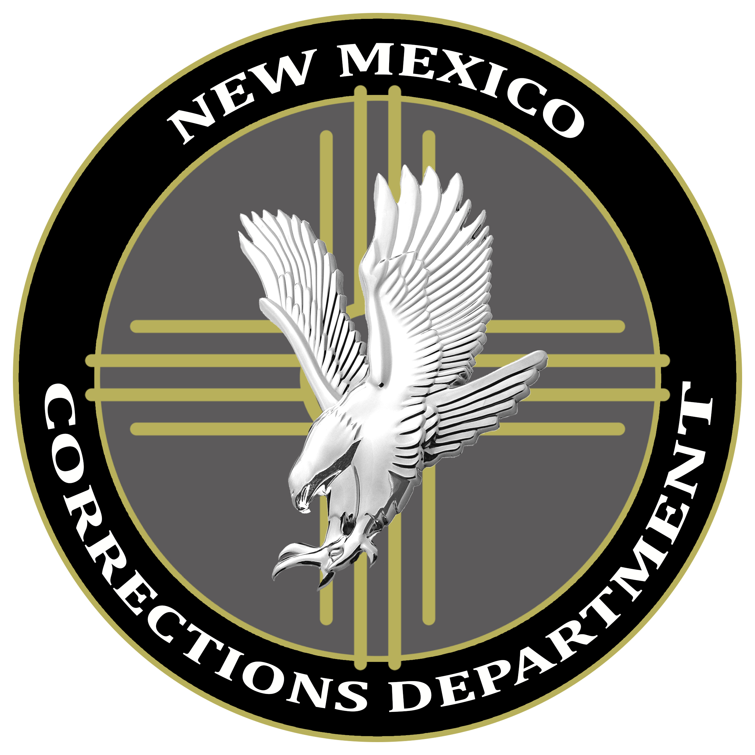
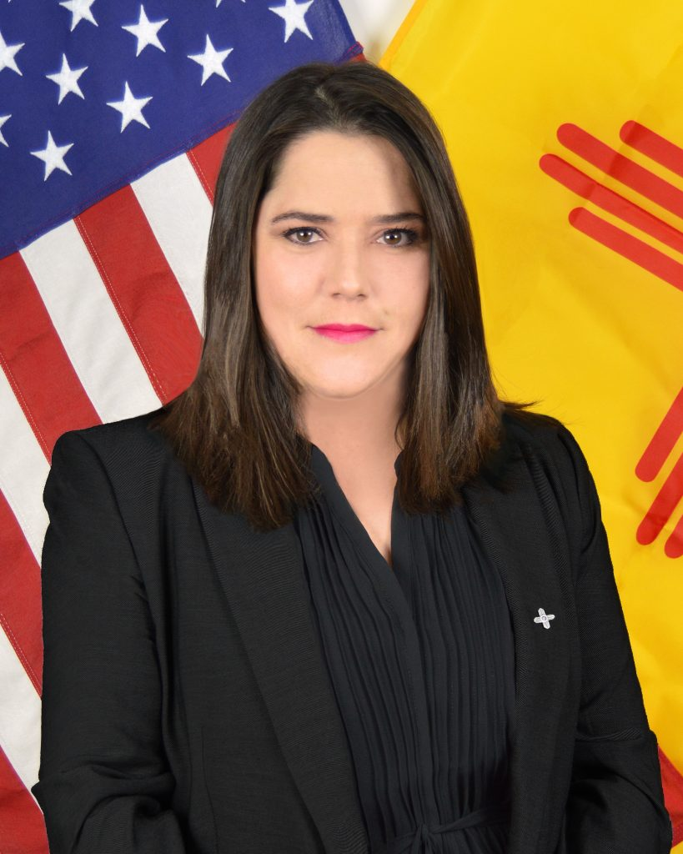
2020 STATE TRIBAL LEADERS SUMMIT
New Mexico Corrections Department
Committed to promoting effective communication and Collaboration with Indian nations, tribes and pueblo
The New Mexico Corrections Department (NMCD) encompasses both adult prisons and Probation and Parole. NMCD is one of the largest State Departments in New Mexico and is fully committed to public safety.
NMCD has 8 different divisions, the largest being the Adult Prisons Division (APD) which covers 11 prison facilities throughout New Mexico, and houses over 6,800 inmates. APD is committed to holding inmates accountable for their actions, along with integrating programs for rehabilitation and reformation through various services, which reduce the risk of recidivism.
The second largest division of NMCD is Probation and Parole Division (PPD), which supervises over 18,500 offenders at any given time throughout the state. Offenders are required to comply with special conditions of supervision including restitution and counseling, to ensure a smooth transition and integration back into society.
Key Contacts
Tex Joey
Native American Program Coordinator and Spiritual Advisor
Tribal Liaison Cell: (505) 670-4538 Email: Tex.Joey@state.nm.us
Alisha Tafoya Lucero
Cabinet Secretary
Phone: 505-490-1447
Email: Alisha.tafoyalucero@state.nm.us

Slide 2
Traditional Services NMCD provides services to Native Americans in the form of Sweat Lodge Ceremony, Talking Circle Ceremony, Blessing Way Ceremony, Pipe Ceremony, and access to an on-site Spiritual Counselor, who is a peer inmate designated to that role, and cedar or traditional herb smudging. Native Americans can congregate for religious ceremonies and utilize religious items. They are also allowed to have personal religious items such as medicine pouches, and spiritual bundles. NMCD Holy Days Native Americans are allowed to observe the following religious holy days: The Federal Government established American Indian Days of September 24th and 25th as well as their cultural holy days of Spring, March 20th and Fall, September 22nd Equinoxes, and Summer, June 20th and Winter, December 21st Solstices. Re-entry efforts NMCD works closely with tribal leaders and/or designees to prepare Native inmates for release by arranging appropriate post-release residential placement, and other planning to ensure successful reintegration with tribes.
2020 STATE TRIBAL LEADERS SUMMIT
Programs

Slide 3
2020 STATE TRIBAL LEADERS SUMMIT
Accomplishments
In 2020, NMCD addressed inmate requests to plant Indigenous foods. Facility staff understands the importance of ceremonial items and helped inmates obtain certain items, and helped facilities reconstruct and maintain 7 out of 11 sweat lodges around the state.
Program activities slowed down in March 2020 due to the COVID-19 Pandemic, but no slow down to participation or access.

