Slide 1
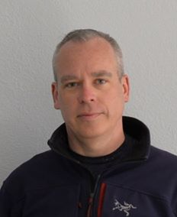
2020 STATE TRIBAL LEADERS SUMMIT
New Mexico Environment Department
Our mission is to protect and restore the environment and to foster a healthy and prosperous New Mexico for present and future generations. New Mexico citizens include the dual citizens of tribes, pueblos and nations and we are committed to be a resource to all by:
Using the best available science to inform our decision-making in protecting public health and the environment.
Employing innovation through engineering and technological solutions to address environmental challenges.
Engaging through collaboration with communities and tribal governments in environmental decision-making outcomes.
Ensuring meaningful compliance with state regulations and permits; leveling the playing field through enforcement.
Cabinet Secretary James Kenney james.kenney@state.nm.us
Deputy Secretary Jennifer Pruett
jennifer.pruett@state.nm.us
Tribal Liaison Kathryn Becker
Kathryn.becker@state.nm.us

Slide 2
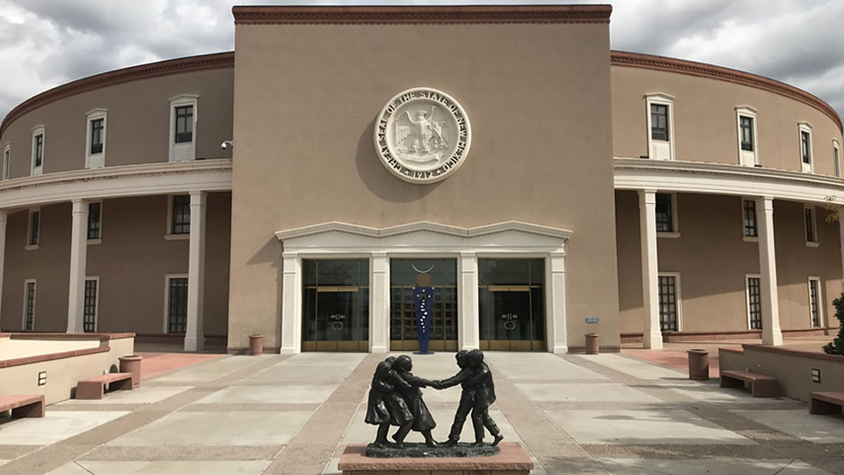
2020 STATE TRIBAL LEADERS SUMMIT
2021 Legislative Session Priorities
Governor priorities
Agency solvency

Slide 3
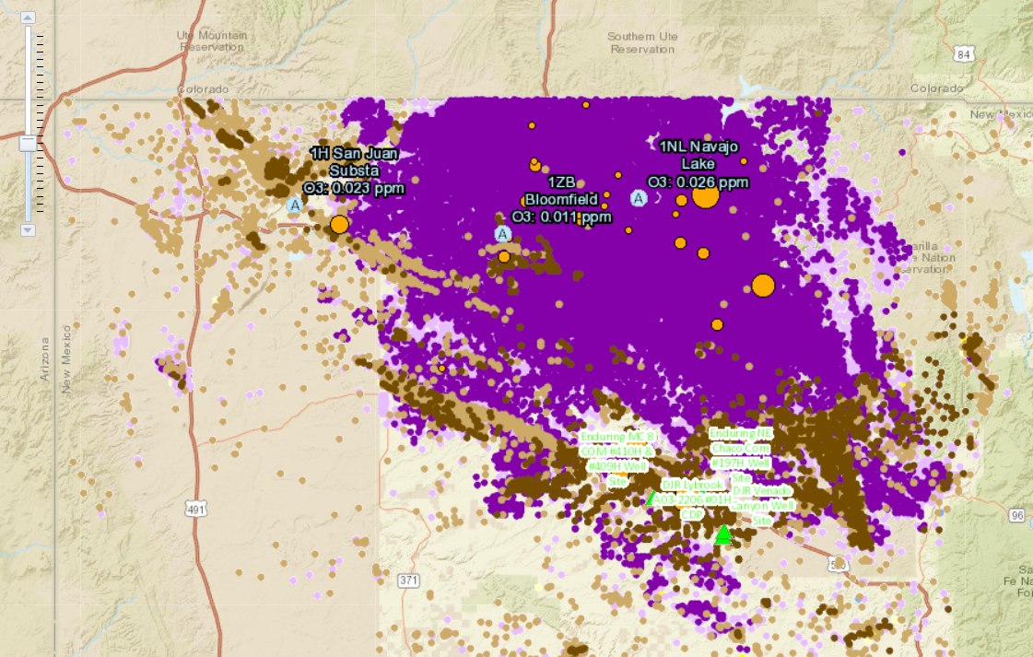
2020 STATE TRIBAL LEADERS SUMMIT
2020 Policy Initiatives/Programs
Air Quality (Climate Change)
NMED has released draft rules that target ozone precursors to reduce methane emissions and is working hard to implement the Governor’s Climate Change initiatives, as set forth in the January 2019 Climate Change Executive Order.
NMED compiled a GIS map showing all flyovers and excess emissions reported for the last five years. We are committed to reducing methane emissions in the Four Corners area and the southeast area of the state.
COVID-19 Response
NMED has been a frontline first responder agency in the Governor’s Rapid Response initiative to COVID-19. NMED has resources for restaurants, drinking water systems, employers and employees, solid and household waste, wastewater and treated effluent and industry and business (oil & gas industry and petroleum storage tank owners and operators).
NMED participates in daily response actions through the Occupational Health and Safety Bureau and the Environmental Health Bureau to ensure information is shared about COVID-Safe Practices and employers are investigated for not adhering to COVID-Safe Practices or providing an unsafe workplace. We are committed to providing the most up-to-date data and information to reduce transmission and keep the public informed.

Slide 4
2020 STATE TRIBAL LEADERS SUMMIT
2020 Achievements
Enhanced outreach to tribal governments on upcoming rule makings through public meetings and visits to tribal leadership in their offices. As soon as COVID-19 allows, NMED will resume hosting a workshop on Hemp Production and Manufacturing in Indian Country with the New Mexico Department of Agriculture.
Enhanced collaborative enforcement regarding illegal discharges with the Pueblo of Picuris and with the Pueblo of Pojoaque.
Awarded three Recycling and Illegal Dumping (“RAID”) Act grants to pueblos to establish recycling facilities, purchase equipment, perform marketing, purchase products produced by a recycling facility, provide educational outreach, develop recycling infrastructure, or abate illegal dumpsites. NMED planned to present information about RAID Act grants at the EPA Regional 6 Tribal Conference at Santa Ana Pueblo on March 24, 2020, but the event was cancelled due to the COVID-19 pandemic and will be re-scheduled when safe.
Applied for and received a $200,000 competitive grant from the U.S. Environmental Protection Agency (EPA) to assist San Juan College in developing and implementing a water utility operator recruitment and training program while addressing challenges associated with COVID-19. The grant, intended for underserved populations hit hardest by COVID-19, will ensure more certified operators are deployed to drinking and wastewater systems in rural areas of northwest New Mexico, including tribal communities. The project is aimed toward recruitment and training for both those entering the workforce for the first time and experienced workers, including those displaced by the shifting energy economy. NMED thanks the Navajo Tribal Utility Authority and the Ute Mountain Ute Tribe, which each submitted letters of support for the program that emphasize the need for utility operators in tribal and Four Corners communities.

